Slide 1
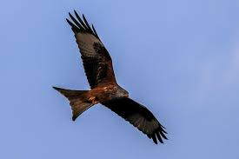
Thursday 14th September 2023
Red Kite Class
Parents' Welcome Meeting

Slide 2
Aims
New to UKS2
New Expectations
Morning teaching overview
Afternoon teaching overview
Homework
Reading
Any questions?

Slide 3
New to KS2
Confident – expected to explain and share new learning and to approach learning with growth mindset. E.g. it is hard but it is worth it.
Valued – pupils wellbeing at the centre. Worry box. Time to talk. Inspirational assemblies. Circle time.
Prepared – increased responsibility for school day readiness; snack, P.E. kit, reading record, homework.
Successful - Increased emphasis on pupils responsibility for learning.

Slide 4
Behaviour
High expectations of social and academic behaviour agreed by class in our class agreement.
Not a quiet classroom.
Pupils clear on their own roles within the classroom.
Conversations between staff and pupils focused on actions and consequences.

Slide 5
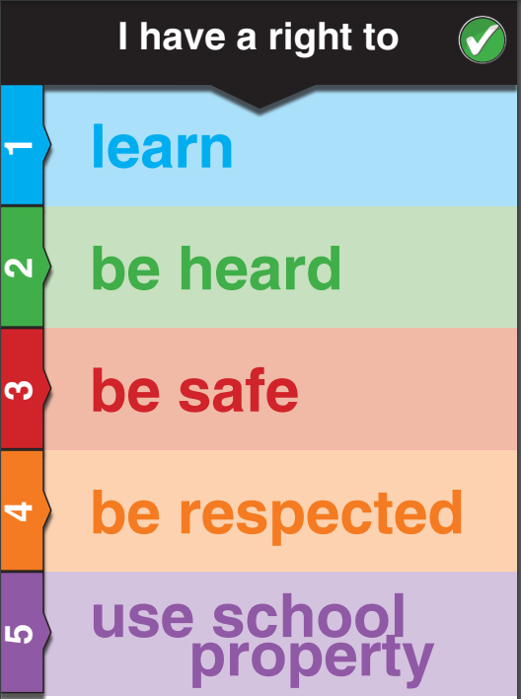
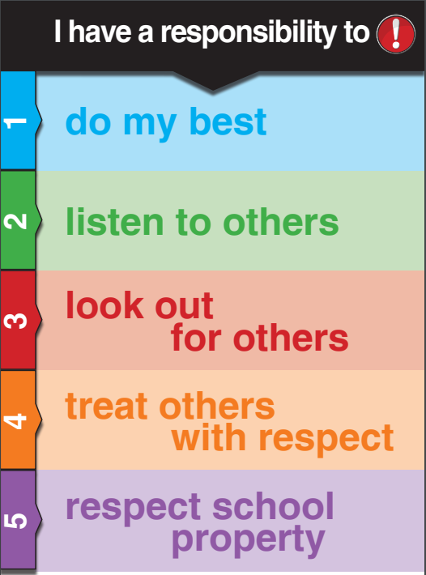
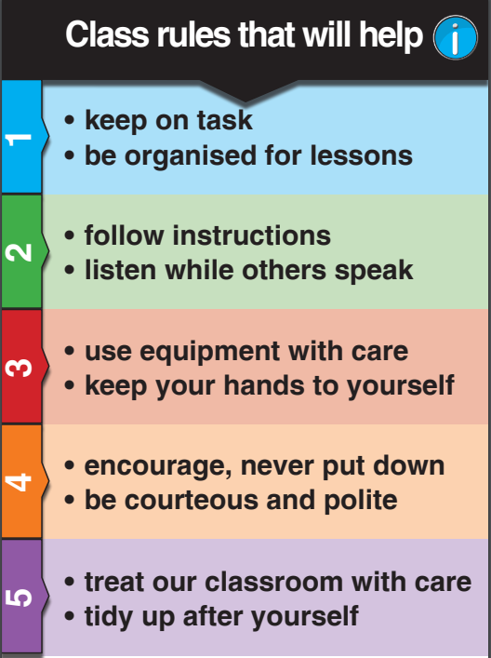
Rights and Responsibilities – Charter

Slide 6
Morning teaching overview
Assemblies; Whole School, Pupil Recognition and Singing
SPAG
Morning run
Maths
English
Guided Reading

Slide 7
Afternoon teaching overview
Humanities (WWII)
Science (Light and Electricity)
Music
Art / DT (Mrs Hedger – Tuesday PM)
Computing (Mrs Hedger – Tuesday PM)
Spanish
PSHE
RE
PE (Sports Coach - Friday PM)
Assemblies: KS2 / Big Think Time

Slide 8
Homework – joint h/w diaries & reading records
Daily – 20 minutes reading and 30 minutes at weekend
Weekly – Topic Menu
Weekly- Maths
Fridays – Spellings and Times Tables (tested weekly)

Slide 9
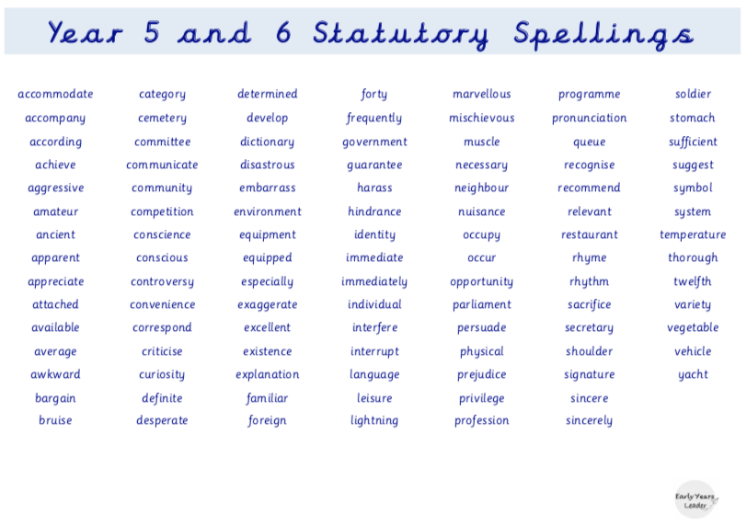
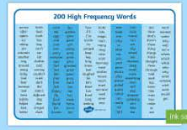
Spellings

Slide 10
Topic: Menu to be sent home. Pupils have until their return from half term to complete the tasks. They will be showcased in our museum.

Slide 11
Any questions?

