Slide 1
Spelling, grammar and punctuation.
Red Kite Class
Notes:
BS 2013

Slide 2
Nouns – 4 different types of nouns – these are two common nouns and proper nouns
A common noun is a noun which is not the name of any particular person, place or thing, e.g. dog, cup, curtain. We can usually point at something with the name of a common noun – if we can see it, of course! A common noun does not usually begin with a capital letter – unless, of course, it is the first word in a sentence.
Name the common nouns in these sentences. Be careful not to name any nouns that are not common nouns – and there will be lots of them.
1 On Sunday I enjoy a boiled egg with my breakfast.
2 Both Bill and Ben scored two goals each.
3 Suzie bought a lovely pink blouse at Primark.
4 The seagulls at Island Wall often make a terrible racket.
5 WJS is situated near the library in Oxford Street.
6 Cats, in my opinion, are more independent than dogs.
Notes:
BS 2013

Slide 3
Nouns – 4 different types of nouns – these are two common nouns and proper nouns
A proper noun is a noun that names a particular person, place or thing, e.g. David, Edinburgh. Atlantic Ocean, Wednesday.
1 ……. …… is a member of the group called One ……… .
2 The ……. Games of 2012 were held in …… .
3 Luis …… plays for ……… Football …. .
4 The ….. …… novels were written by JK ……. .
5 Mr. …… wrote …. …. A …. for W.. .
6 ……. Castle stands in the north east of …….. .
Notes:
BS 2013

Slide 4
Nouns – 4 different types of nouns – these are two - common nouns and proper nouns
Identify the common and proper nouns and ignore any others at the moment.
The Terrible Tale of Pirate Pete
Pirate Pete was born in Dover. He became a pirate when he was only a thirteen-year-old lad. He sailed on many ships – his most famous ship was the Revenge. He fought in many battles. He had many adventures. He loved the life. Unfortunately he was not always lucky.
Pirate Pete had his left leg blown off by a canon ball during a battle off the coast of Malta in the Mediterranean Sea, so he was sometimes called Peg-Leg Pete.
Pete had his right hand chopped off during a sword fight at a pub called the Sailor’s Arms in Folkestone. That is why he has a hook for a hand.
Of course you will be wondering why Pirate Pete wears an eye-patch over his left eye. Did he lose his eye in a sea-battle or a sword-fight? No, he did not.
One day Pete got a terrible itch in his left eye. For a moment he forgot about his hook and tried to scratch the itch with his fingers.
This was not a good idea!
Notes:
BS 2013

Slide 5
Nouns – 4 different types of nouns – these are two common nouns and proper nouns
A proper noun
If used as a pronoun – needs a capital letter
“How are you feeling, Mum?”
“Do you know where my shoes are Dad?”
“Gran, come over here!”
Direct name used, you would use a capital letter.
However, if you’re writing about a family member and the title is modified by our/your/my/his/her/etc, then it doesn’t take a capital and would be:
“How is your mum feeling?”
"My mum is feeling down because of my aunt's drinking."
“Is his dad going fishing with your dad?”
"My dad is going, but his dad isn't."
Notes:
BS 2013

Slide 6
Nouns – 4 different types of nouns – these are two abstract nouns and collective nouns..
An abstract noun is a noun referring to something which cannot be experienced with any of the five senses, such as an idea, thought or emotion, e.g. happiness, love, courage, boredom.
Concrete nouns are people, places, or things that we would experience with our five senses. The abstract class is the opposite - we can never experience these nouns according to our senses. If a noun is abstract, it describes something you cannot see, hear, touch, taste, or smell.
Sometimes it can be difficult to recognize when the noun is abstract because there are a number of words that can function in different ways. For example, some words might function as verbs in some cases and abstract nouns in other cases. Love and taste are two examples.
I love my husband. [In this sentence, the word love expresses an action and is therefore acting as a verb.]
Send them my love. [In this sentence, the word love functions as an abstract noun because it is a thing that exists beyond the five senses.]
Sarah could taste cilantro in the salsa. [In this sentence, the auxiliary verb 'could' functions with taste to illustrate action. She can physically taste the salsa.]
Sarah has great taste in clothes. [In this sentence, taste functions in an abstract manner. Taste refers to her preferences.]
Notes:
BS 2013

Slide 7
Nouns – 4 different types of nouns – these are two abstract nouns and collective nouns..
Emotions/Feelings
Love
Hate
Anger
Peace
Pride
Sympathy
States/Attributes
Bravery
Loyalty
Honesty
Integrity
Compassion
Charity
Success
Courage
Deceit
Skill
Beauty
Brilliance
Pain
Misery
Ideas/Concepts/Ideals
Belief
Dream
Justice
Truth
Faith
Liberty
Knowledge
Thought
Information
Culture
Trust
Dedication
Movements/Events
Progress
Education
Hospitality
Leisure
Trouble
Friendship
Relaxation
Nouns with the following suffixes are often abstract:
-tion
-ism
-ity
-ment
-ness
-age
-ance
-ence
-ship
-ability
-acy
Notes:
BS 2013

Slide 8
Nouns – 4 different types of nouns – these are two abstract nouns and collective nouns..
An abstract noun is a noun referring to something which cannot be experienced with any of the five senses, such as an idea, thought or emotion, e.g. happiness, love, courage, boredom.
1 There was great excitement when Arsenal scored the first goal. (1)
2 Sometimes it takes bravery to tell the truth. (2)
3 After the marathon, I collapsed with exhaustion. (1)
4 At WJS we realise the importance of a good education. (2)
5 Take pride in your achievements! (2)
6 Childhood should be the happiest time of your life. (3)
7 Have a little patience. We’ll get there soon. (1)
Notes:
BS 2013

Slide 9
Nouns – 4 different types of nouns – these are two abstract nouns and collective nouns..
1 Romeo and Juliet fell head-over-heels in ......................... .
2 This test shows you are above average .............................. .
3 I haven’t the faintest ..................... what you’re talking about.
4 “We don’t need no .........................,” sing Pink Floyd.
5 It would be wonderful if everyone in the world lived in .......................... .
6 I hope you’re not having too much .......................... with
abstract nouns.
7 This is a wonderful .......................... for you. Don’t miss it.
8 The doctor gave me some very good .................... about my health.
9 Susan’s ............................. has really increased in the last
six months.
Notes:
BS 2013

Slide 10
Nouns – 4 different types of nouns – these are two abstract nouns and collective nouns..
A collective noun is a noun referring to a group or collection of people, creatures or things, e.g. a crowd of people, a flock of sheep, a bunch of bananas.
1 The whole team was excited to win the trophy.
2 There’s a family of snakes amongst those rocks.
3 A gaggle of geese waddled across the farmyard.
4 Peter joined the pirate crew when he was only thirteen.
5 Elliot was thrilled to join the cathedral choir at Canterbury.
Notes:
BS 2013

Slide 11
Nouns – 4 different types of nouns
In the following sentences, label each of the underlined nouns as:
CL (common) - PR (proper) - AB (abstract) or CL (collective)
The party of tourists were delighted to visit the Tower of London.
Excitement filled the stadium as the teams ran onto the pitch.
Private Ryan won the Victoria Cross for courage under fire.
The sky was filled with a company of angels led by Gabriel.
Pass me that ream of paper, please, Leo.
Notes:
BS 2013

Slide 12
Adding suffixes beginning with vowel letters to words of more than one syllable
Notes:
BS 2013

Slide 13
Adding suffixes beginning with vowel letters to words of more than one syllable
forget
begin
prefer
garden
limit
Notes:
BS 2013

Slide 14
Adding suffixes beginning with vowel letters to words of more than one syllable
stop hop
refer hope
rob jump
sit throw
Stressed end consonant , with vowel before, double the consonant
Not stressed not doubled.
Short vowel sound – double consonant
Long vowel sound – only one consonant
Notes:
BS 2013

Slide 15
Can you spell these words?
myth
gym
Egypt
pyramid
mystery
Notes:
BS 2013

Slide 16
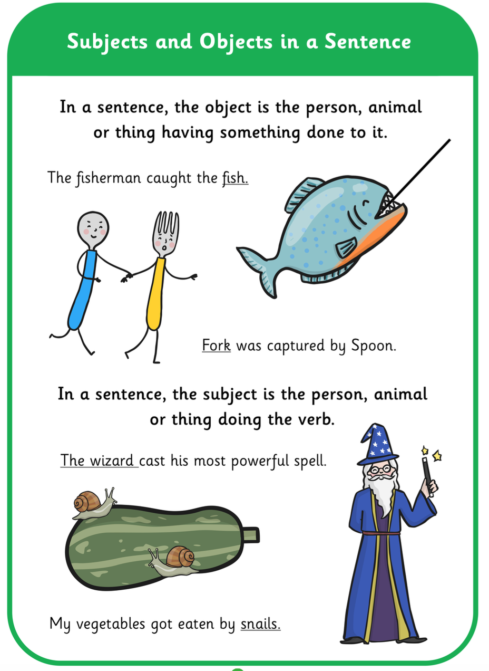
Subject and object
My cat chased a mouse.
Miss Duncan drives a red Metro.
Kasper watered the garden.
Miss Hill ate her dinner.
.
Notes:
BS 2013

Slide 17
Verbs
A verb is the most important word in any sentence. The verb is the doing word, the action word. It is the word which tells us what happens, what is happening, what will happen, what has happened, what happened, and so on. The English language is very rich in verbs. Try to choose verbs that really bring your sentences to life.
.
1 Our cat .......... with the mouse for a while, then he suddenly .......... on it.
2 Archie .......... onto the dance floor and .......... at the nearest pretty girl.
3 “Someone has .......... the Kooh-i-Noor Diamond!” .......... Joe.
4 Tarzan was so hungry he .......... a whole wild pig by himself.
5 What a boy you are! You’re dad will definitely .......... you when we get home.
Notes:
BS 2013

Slide 18
Verbs
Make these sentences far more interesting…..
Amy ran towards the finish line and burst through the tape.
Juliet said, “Romeo, Romeo, wherefore art thou Romeo?”
Ben went under the patio to look for the lost puppy.
Broccoli is something I really don’t like.
The librarian put the books on the shelf in alphabetical order.
.
Notes:
BS 2013

Slide 19
Verbs
Here are some sentences written by people learning English. Can you spot where they’ve used the wrong tense, and replace the verbs with the correct tense?
1 Yesterday I have the chance to eat haggis. It was delicious!
2 On warm days we like to sit and ate ice-cream on Tankerton Slopes.
3 We’re going to the shopping centre where we buy new trainers.
4 I would have done it if you would have told me sooner. (This one is tricky.)
5 I learn English for two years now. (So is this one!)
.
Notes:
BS 2013

Slide 20
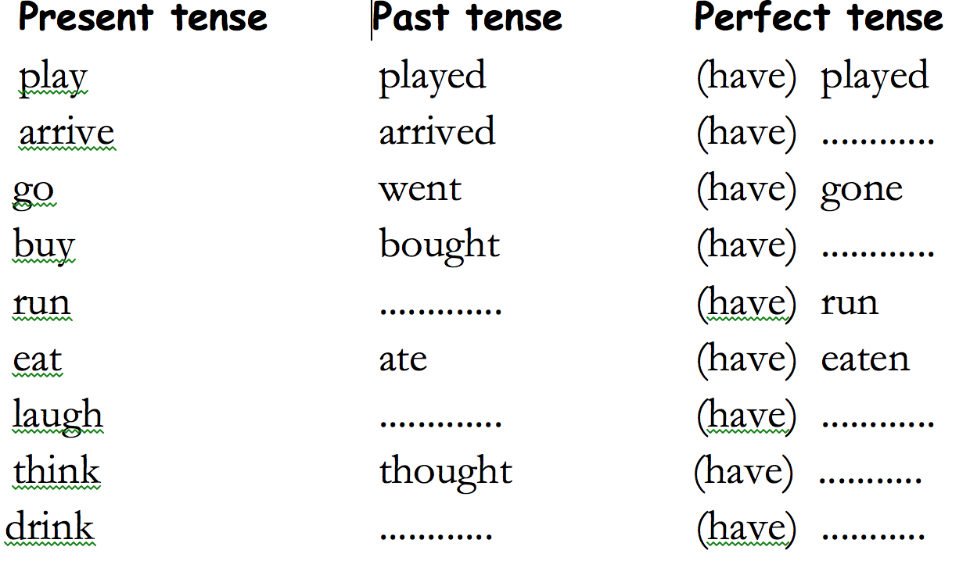
Perfect tense
The PRESENT PERFECT TENSE is formed with a present tense form of "to have" plus the past participle of the verb (which can be either regular or irregular in form). This tense indicates either that an action was completed (finished or "perfected") at some point in the past or that the action extends to the present:
.
Notes:
BS 2013

Slide 21
u sound written as ou.
touch
young
trouble
sound
double
country
pound
found
Notes:
BS 2013

Slide 22
Prefix un – negative meaning.
I used to be tidy, but now I am ___________.
Last week I was happy, but now I am __________.
That was a fair test, but this one is _________.
After the crash, he was hurt but she was _______.
I am prepared for the game, but you are ____________.
This lace is tied, but this one is _______.
I was grateful for my presents, but he was ____________.
She was sure she could find it, but I was ________.
Notes:
BS 2013

Slide 23
Prefix dis – negative meaning (some un too)
Dear Granny,
I am very happy at the camp. Everyone has been very kind to me and I am able to sleep well at night. Yesterday we played a game which was very fair. I was lucky to be in a team with all the older children. They were very honest and wanted to obey all the rules. They made me tie my hair ribbons and I really like having my hair down. I have decided to wrap my present before I dress for bed. Thank you, Granny, for the magic cloak, now I will be able to appear in front of everyone without a worry.
Love from Matilda xxx
Notes:
BS 2013

Slide 24
Prefix dis – negative meaning (some un too)
disappoint
disagree
disobey
Use your dictionaries to find some more – take care with spelling.
Notes:
BS 2013

Slide 25
Prefix mis – negative meaning
1 Barry had made a _________ when completing his
homework.
2 “I have _____________ what I needed to do?” cried
Ben.
3 The children were very naughty, they often
______________.
4 Olivia _________ the words in her spelling test.
Notes:
BS 2013

Slide 26
Prefix in
incomplete insect
ingredient insolent
interest instrument
indoors inedible
inhabit interview
invest infect
instead industry
1 Polar bears ------------ the Arctic region of the world.
2 A butterfly is an -------------.
3 Because the weather was bad we played -------
4 I need to -------- some of my wages for when I am older.
5 My homework was not finished :it was -----------
6 The mouldy cheese was -----------------
7 People with coughs can easily ------------ others
8 Paul went to the concert ---------- of his sister, Ann.
9 Dad went for an ------------- for a new job.
Notes:
BS 2013

Slide 27
Adverbs
1 Adverbs are words that we use to describe other words. They can be used to describe verbs, adjectives, and even other adverbs. For the moment, we are going to study how adverbs are used to tell us something more about verbs. Most adverbs finish with –ly (quickly, carefully, gently, cautiously), but there are few that don’t. Think of an adverb as a word that adds something to a verb. These are called adverbs of manner.
Notes:
BS 2013

Slide 28
there
their
they’re
There – making a statement or writing about a place.
Their – belonging to them
They’re - instead of saying ‘they are’
1. The teacher told them to leave …….. books on the desk.
2. Billy is always ……. on time.
3. ………. are over 900 students at our school.
4. Ask them if ……….. coming tomorrow.
5. Dad was pleased they had done well in ………. exams.
6. We’ll go to McDonalds if ………. is time.
7. ………. baking a cake for their Grandma.
8. Can you give me ……… telephone number?
9. My parents won’t be coming as ………… both working on Saturday.
Notes:
BS 2013

Slide 29
however
but
because
despite
yet
Pick the best connective from above for each sentence below:
1. Ben went to the doctor ___________ he was feeling ill.
2. Sam was happy, ___________ he felt tears fill his eyes.
3. Jimmy entered the room __________ feeling nervous.
4. His face turned red ___________ he was embarrassed.
Notes:
BS 2013

Slide 30
Pick the correct word or words from the options for each sentence below:
The window was broke / broken / broked / breaked by the ball.
Mandy writ / wrote / witten / has wrote a letter.
Benjie has eaten / eated / ate / eaten a large cucumber.
Use I or me for each sentence below:
I wanted Dad to watch ________ in the football match.
He walked to school with Danny and ____ .
My teacher told Terry and ____ to collect the books.
Eddie came to school with Jim and _____ .
Ben and ____ are going to the cinema tomorrow.

Slide 31
Which of the words below need a capital letter?
billy came to our school today from canada. he wants to learn french.
we enjoyed visiting prince rock primary school on wednesday.
all the english supporters waved their flags when england scored a goal.

Slide 32
Use the correct gremlin verb in each sentence below:
are
is
has
have
Benny and James ___________ gone outside.
The dogs ___________ sitting by the fire.
Sammy ____________ remembered his homework.
My football coach __________ teaching me how to dribble.
Elephants ______ wonderful animals.
I love my bags. They _____________ beautiful.
School uniform __________ better than mufty.
He _____ gone away on holiday.
Notes:
BS 2013

Slide 33
For each piece of text below, pick which box should have the ? or !
Sam asked, “Can I go to the toilet□” □ after he had sat down in the car. □
“Wow □” □ exclaimed Benny, “I can’t believe I got full marks.”
My mum whispered □, “Would you like to eat the last bit of ice-cream □” □
Now write any question on your whiteboard.

Slide 34
For each sentence below, state whether they are a question, command or statement.
He liked the sandwich I made for him
Can I go to the toilet
Wow
Please wait over there
Do you know the way to Florida
Go outside and wash your shoes
Eat that cake now
I may like to come with you tomorrow
Now pick ! ? or . to end each sentence.

Slide 35
Look at the underlined words. Which are nouns and which are adjectives? Make two lists on your whiteboards.
I thought the play was boring but James said he was excited when he listened to the songs.
Carefully I opened the box. Inside I found a red hat and a blue coat.
Yesterday I bought: a new pencil; 15 handmade cookies; a selection of pens and a large grapefruit.

Slide 36
Which of these sentences use the correct plural?
Select the correct plural for each sentence.
The child / children / childs are playing on the field.
Women / woman / womens / womans are welcome to use the upstairs toilet.
Sheeps / sheep look nice and warm with their thick coats.
I like to watch the fishes / fish / fishs at the aquarium.
My foots / feets / feet ache today.
The mouses / mice / mices enjoyed the cheese.
a. The childs are eating lots of cake.
b. Gentleman usually wear trousers or shorts.
c. The children enjoyed watching the play.

Slide 37
Write down the number of verbs in each sentence.
Ben enjoyed watching TV.
Suzy enjoyed watching TV while eating cake.
I like playing football with Raj on the field.
He is huge!
Eating cake is one of my favourite hobbies!
Quietly she wondered into the hall while it was dark.
I am being very noisy today!
My dog and I are enjoying our walk.

Slide 38
Which sentences below use commas correctly?
He bought fish, chips, mushy, peas and a can of coke.
We collected leaves, twigs, stones, and seeds from the field.
My brother ate cake, an apple, a banana a fish and a packet of pork, scratchings.
In the bag I found, pens, pencils, crayons and a ruler.
My favourite lessons are maths, history and geography.
Can you write your own list sentence that uses colons and semi-colons?

Slide 39
Find the verbs and the adverbs below. Make two lists on your whiteboard.
Casually, Raj strolled into the room and looked slowly around.
Running quickly, Sally escaped from the galloping horse. She tripped carelessly on a fallen log.
Whilst out for a winter jog, Manjip was very tired.
Now write any question on your whiteboard.

Slide 40
Look at the underlined words in the sentences below. Replace them with words that have a similar meaning.
He liked eating cake.
Casey had a nice coat to wear.
“Ouch!” said Mrs Fox.
Which of these is the biggest?
In the dark she felt anxious.
My favourite book is the one with the red cover.
Now make a list of alternative words for said.

Slide 41
Brackets can be used in each sentence below. Write down the words that should be included in brackets.
James my brother likes eating cake.
Hillary the woman who lives down the road enjoys playing rugby.
The bus the one with the yellow bumpers crashed yesterday.
His mother who enjoys snooker knitted me a waistcoat last week.
Elephants especially the big ones leave large footprints.

Slide 42
Sort these words into 3 columns: nouns, verbs and adverbs.
to run
very
eat
monster
casually
slowly
cake
be
am
cat
Now write any exclamation on your whiteboard.

Slide 43
Change all the underlined verbs from the past tense to the present tense.
I ran all the way home.
He hides under the table.
I waved at the queen and shouted.
I was thinking about my maths.
They were running towards the hill.
We were making lots of mess.
Now write a sentence in the past tense and then rewrite it in the present tense.

Slide 44
Find the adjectives and nouns in the sentences below. Make two lists.
The old man often makes delicious pies.
Noisy children enjoy playing in the outdoor den.
Please could I have a large fish and small portion of chips?
What happened to that enormous building?
Where can I find a nice restaurant that serves healthy food?

Slide 45
Find the connectives in the sentences below.
It was raining whilst he ate his pie.
Sunny weather always makes people smile and laugh.
Although it was windy, he still wore his hat.
Walking quickly, the elderly lady grasped her hat as she thought it would blow off.
It is sunny today. However, my teacher says we must stay inside.

Slide 46
Copy and complete the table of irregular plurals.
(the first one has been done for you)
One | Many
table | tables
 | windows
fish
sheep
 | children
woman
goose
tooth
 | men
 | women
Can you think of any other irregular plurals?

Slide 47
Which of these sentences should be written as two separate sentences?
I am a boy and my sister is a girl.
Raj is a beautiful boy he likes cake.
I eat cake while I watch TV.
Whenever we go to the shops I see my granny.
It was raining last week I had to wear a coat.
Can you get a towel for me please I am soaking wet.

Slide 48
Sort these nouns into common nouns, proper nouns, abstract nouns and pronouns.
plymouth
shop
tesco
dog
thoughtfulness
elephant
bradley
joe
table
happiness
his
wales
dad
primary school
lipson
her
i
my brother
mum
Now add capital letters to the proper nouns

Slide 49
Pick the correct word for each sentence below.
We was / were eating cake.
I was / were eating cake.
Jimmy go / goes to school with me.
I go / goes to school with Jimmy.
My dogs takes / take me for a walk.
My dog takes / take me for a walk.
We are /am brilliant at grammar.
I are / am brilliant at grammar.

Slide 50
Add some adverbs to the spaces below.
Shirley ran ________________ to the castle and crept ____________ up the stairs.
While I milked the cow _____________, he ___________ groomed the horse.
The child _______________ shouted at the man who was running ____________ .

Slide 51
Which clause is in bold in the sentences below? Main or subordinate?
The car, which was old and battered, raced to the finish line.
The test was easy because it only had two questions.
Although it was raining, we still went out to play.
While the birds were singing I hid under my pillow.

Slide 52
Where do the inverted commas belong? Copy the sentences below.
Wonderful said the teacher.
It’s ugly, said the boy, and I won’t wear it.
What are you doing? Shouted the teacher.
I’m chasing that cat! He replied.

Slide 53
Write the correct contraction to replace the underlined words.
I can not eat that cake, it is too big!
He will not go outside because he is afraid.
I will try my best but I can not promise to get it right.
Do not shout at me or I will send you to your room.
You are annoying me today.

Slide 54
Have the apostrophes been used for omission or possession? Write o or p for each sentence.
The girl’s bag is heavy.
I wouldn’t go in there if I were you.
She wanted to see Billy’s new book.
The frogs were croaking in Ben’s face.
I’m going to get you!
I couldn’t find the peg.
She’d like to meet you.
Can I see Sarah’s homework please?
I can’t do it!
Sally’s hair is the prettiest.

Slide 55
Find the article in the sentences below.
We went to the park.
We sat on the table.
He rode a bike.
Walking along the beach is fun.
We bought an orange.
Choose the correct article.
He sat on a / an coach.
He ate an / a apple.
She cut up a / an onion.

Slide 56
Find the preposition in the sentences below.
I put the cat on the table.
I wanted to go out until 8 o'clock.
She drove near the river.
We walked through the forest.
During the storm we hid under the house.
She swam across the river.
We played outside the park.
Under the bed, the lazy cat was having a snooze.

Slide 57
Write the following in the passive voice.
Ben kicked a football at the window.
Charlie ate the cake.
George kissed all the girls!
Jasmine rocked the baby to sleep carefully.

Slide 58
Brackets (parenthesis) – put the brackets around the correct information.
Jimmy the boy next door enjoyed football.
Yesterday when it was sunny we ate cake.
The chocolate bar which contained 400 calories was enjoyed by everyone.
Our local supermarket Sainsbury’s is very busy on a Saturday.
Now make a list of 10 proper nouns.
And finally, write a question beginning with Which

Slide 59
Write down the omitted letters for each word.
Don’t
Haven’t
Can’t
I’ll
We’re
We’ll
Won’t
She’s
They’re
Shouldn’t

Slide 60
Find the adverbs and adjectives below.
Make two separate lists.
It was a cold day when the tired baker wondered slowly to work.
My favourite toy is the one that quickly crawls along the floor.
My mad dog, Spot, very much likes to chase his tail.
Tracy, the butcher’s daughter, enjoys eating small children.

Slide 61
Find the abstract nouns
happiness
hope
car
dog
weather
pencil
David
Mrs Smith
trust
table
curiosity
worry
drawer
Primark
relaxation
airplane
bubble bath
pain
confusion
board
pleasure
loyalty

Slide 62
Sentence types
Simple sentences
A simple sentence has a subject and a verb.
The tiger growled.
The young girl sprinted across the road.
The kettle boiled.
The 3 types of sentences are:
Simple
Compound
Complex
Today we are going to be looking at complex sentences, but first, we are going to recap simple and compound sentences.

Slide 63
Sentence types
Compound sentences
A compound sentence is when two sentences are joined by a conjunction.
I love bananas. I don’t like grapes.
I love bananas but I don’t like grapes.
.

Slide 64
Sentence types
Complex Sentences
These are formed when you join a main clause and a subordinate clause together.
Main clause – has a subject and a verb and makes sense on its own.
Subordinate clause – does not make sense on its own.
.

Slide 65
Sentence types
The subordinate clause can be put before the main clause:
Although I was scared, I carefully crossed the bridge.
Or in the middle of the main clause:
David, who had a sore throat, sang beautifully.
.

Slide 66
Sentence types
Can you identify the subordinate clause in each sentence?
Emily who was a small and cheerful girl was on her way to school.
My brother who is very tall is much older than me.
Mr Smith who worked as a secret agent flicked through the paper silently.
.

Slide 67
Sentence types
.

Slide 68
Relative clauses
.
Tells us more about the noun.
Who for people
Which for things
That for people
Whose can be used for people
When and where can also be used.

